Slide 1
Removing Additive Structure in 3SUM-Based Reductions
Ce Jin
MIT
Yinzhan Xu
MIT
STOC’23
arXiv:2211.07048
Notes:
25min

Slide 2
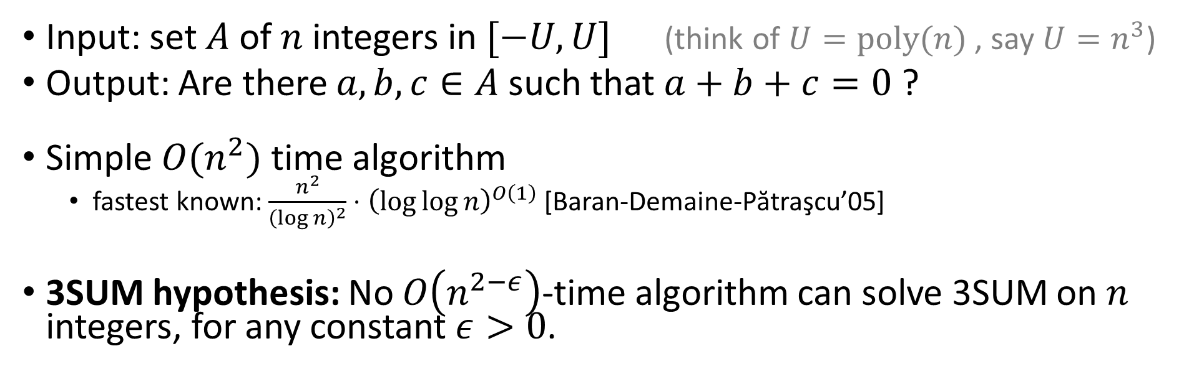
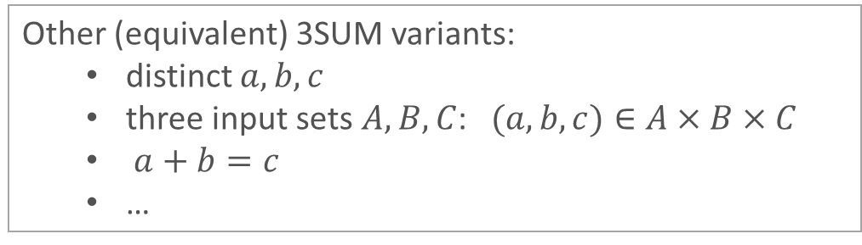
3SUM problem (on integers)
Input: set $A$ of $n$ integers in $[−U,U]$ (think of $U=poly(n)$ , say $U=n^{3}$)
Output: Are there $a,b,c∈A$ such that $a+b+c=0$ ?
Simple $O(n^{2})$ time algorithm
  fastest known: $\frac{n^{2}}{{\left(\log{n}\right)}^{2}}⋅{\left(\log{\log{n}}\right)}^{O\left(1\right)}$[Baran-Demaine-Pătraşcu’05]
3SUM hypothesis: No $O\left(n^{2−ε}\right)$-time algorithm can solve 3SUM on $n$ integers, for any constant $ε>0$.
This work: new LBs from 3SUM hypothesis
(via additive-combinatorial techniques)
Other (equivalent) 3SUM variants:
  distinct $a,b,c$
  three input sets $A,B,C$: $(a,b,c)∈A×B×C$
  $a+b=c$
  …

Slide 3
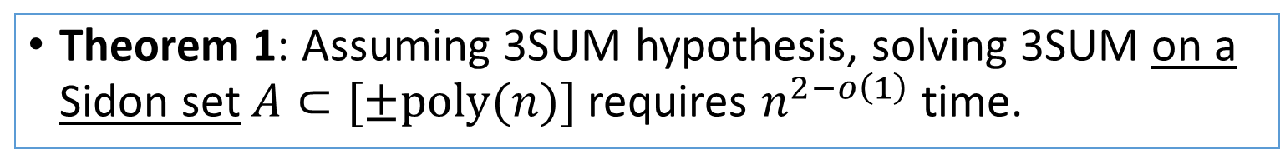


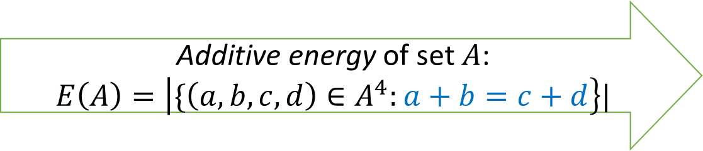
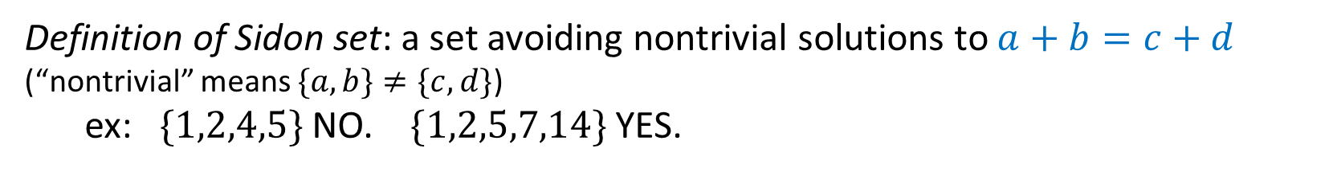
Theorem 1 (Our main technical result)
Definition of Sidon set: a set avoiding nontrivial solutions to $a+b=c+d$ (“nontrivial” means $\{a,b\}≠\{c,d\}$)
ex: $\{1,2,4,5\}$ NO. $\{1,2,5,7,14\}$ YES.
(Sidon equation)
Theorem 1: Assuming 3SUM hypothesis, solving 3SUM on a Sidon set $A⊂[±poly(n)]$requires $n^{2−o\left(1\right)}$ time.
“3SUM instances with no additive structure are the hardest!”
no additive structure
(e.g., random numbers from a large range)
a lot of additive structure
(e.g., arithmetic progression)
Additive energy of set $A$:
$$E\left(A\right)=\left|\{\left(a,b,c,d\right)∈A^{4}:a+b=c+d\right\}|$$
$$2{\left|A\right|}^{2}−\left|A\right|$$
$$Θ({\left|A\right|}^{3})$$
(Sidon set)

Slide 4

Plan
Theorem 1: Assuming 3SUM hypothesis, solving 3SUM on a Sidon set $A⊂[±poly(n)]$requires $n^{2−o\left(1\right)}$ time.
“3SUM instances with no additive structure are the hardest!”
Applications of Theorem 1 in fine-grained complexity:
  Tight LB for listing 4-cycles
  Improved LB for building approximate distance oracles
  Tight LB for solving 4-term linear equations in a given set (“4-LDT problem”)
Independently by [Abboud, Bringmann, and Fischer STOC’23]
Proof ideas for Theorem 1

Slide 5
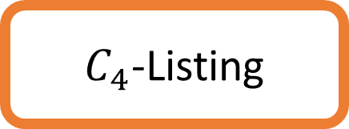
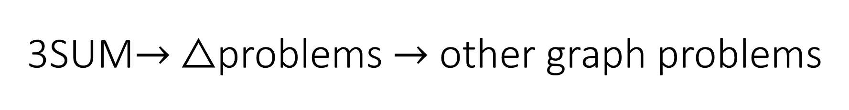
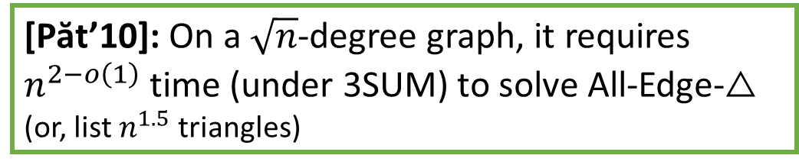
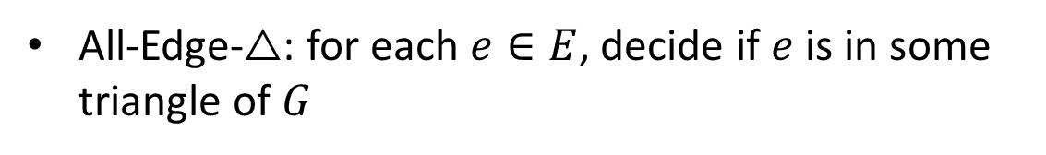
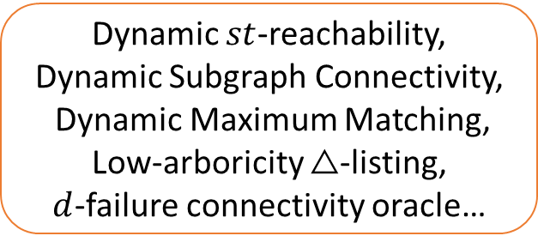
3SUM$→$ △problems $→$ other graph problems
3SUM
[Păt’10,KPP’16]
$C_{4}$-Listing
△-listing
or [VW’09+VX’20]
Cycle-removal [Abboud-Bringmann-Khoury-Zamir’22]
[DKPV’20]
All-Edge-△
Approximate Distance Oracle
[Păt’10,AV’14,KPP’16,…]
All-Edge-△: for each $e∈E$, decide if $e$ is in some triangle of $G$
Dynamic $st$-reachability,
Dynamic Subgraph Connectivity,
Dynamic Maximum Matching,
Low-arboricity △-listing,
$d$-failure connectivity oracle…
[Păt’10]: On a $\sqrt{n}$-degree graph, it requires $n^{2−o\left(1\right)}$ time (under 3SUM) to solve All-Edge-△ (or, list $n^{1.5}$ triangles)

Slide 6

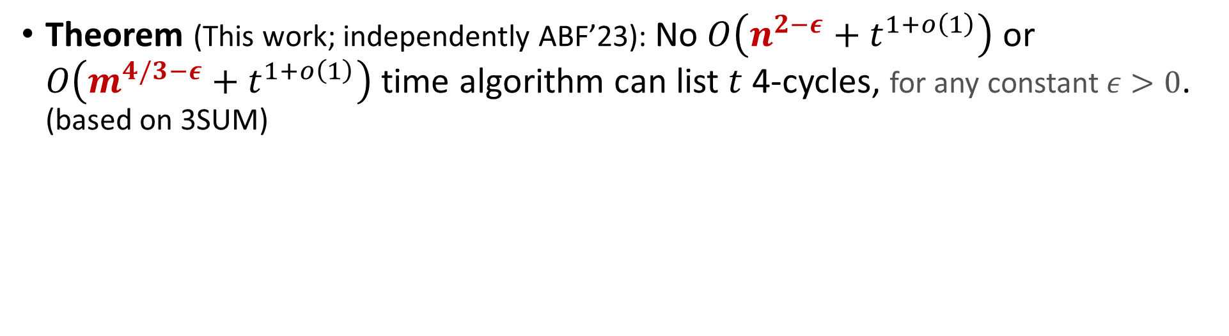
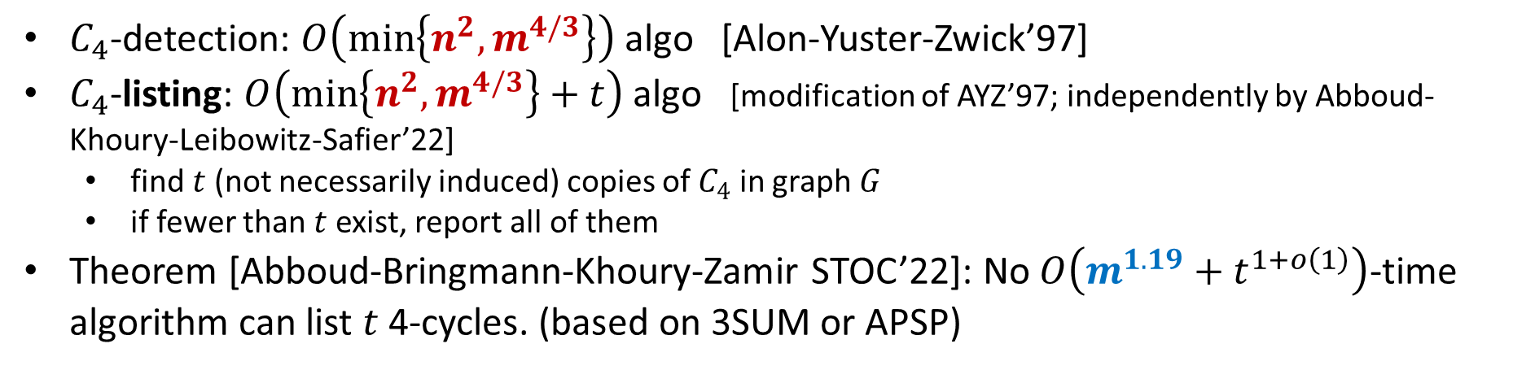
Listing $t$ 4-cycles (undirected, non-induced)
$C_{4}$-detection: $O\left(\min\left\{n^{2},m^{4/3}\right\}\right)$ algo [Alon-Yuster-Zwick’97]
$C_{4}$-listing: $O\left(\min\left\{n^{2},m^{4/3}\right\}+t\right)$ algo [modification of AYZ’97; independently by Abboud-Khoury-Leibowitz-Safier’22]
  find $t$ (not necessarily induced) copies of $C_{4}$ in graph $G$
  if fewer than $t$ exist, report all of them
Theorem [Abboud-Bringmann-Khoury-Zamir STOC’22]: No $O\left(m^{1.19}+t^{1+o\left(1\right)}\right)$-time algorithm can list $t$ 4-cycles. (based on 3SUM or APSP)
Theorem (This work; independently ABF’23): No $O\left(n^{2−ε}+t^{1+o\left(1\right)}\right)$ or $O\left(m^{4/3−ε}+t^{1+o\left(1\right)}\right)$ time algorithm can list $t$ 4-cycles, for any constant $ε>0$. (based on 3SUM)

Slide 7
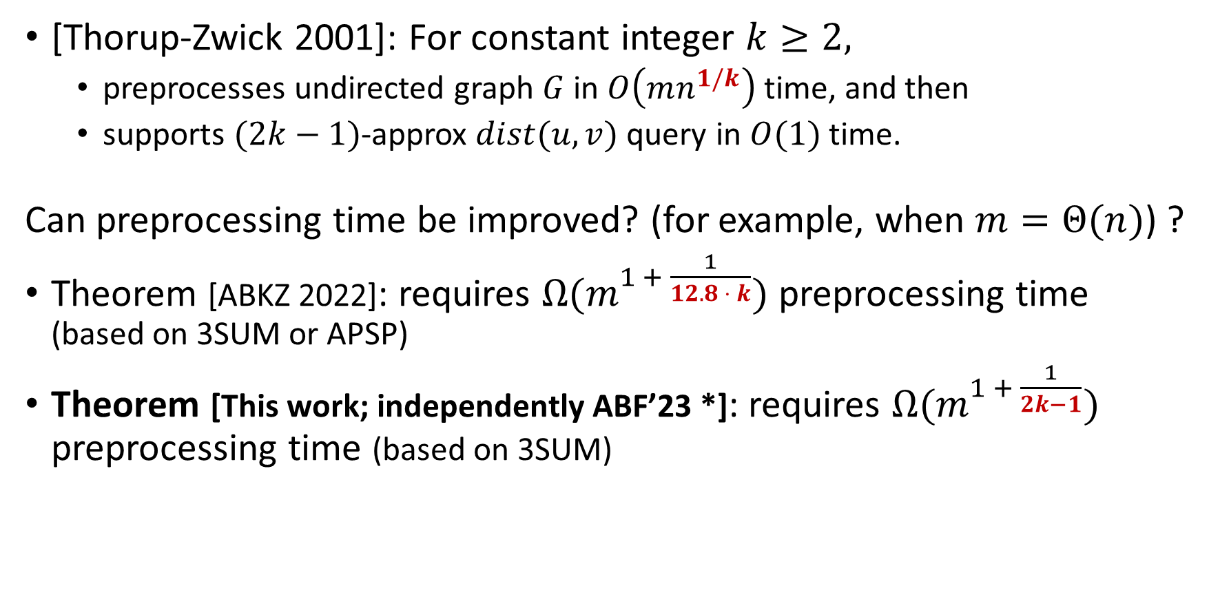
Distance Oracles
[Thorup-Zwick 2001]: For constant integer $k≥2,$
  preprocesses undirected graph $G$ in $O\left(mn^{1/k}\right)$ time, and then
  supports $(2k−1)$-approx $dist(u,v)$ query in $O(1)$ time.
Can preprocessing time be improved? (for example, when $m=Θ(n)$) ?
Theorem [ABKZ 2022]: requires $Ω{(m}^{1 + \frac{1}{12.8 ⋅ k}})$ preprocessing time (based on 3SUM or APSP)
Theorem [This work; independently ABF’23 *]: requires $Ω{(m}^{1 + \frac{1}{2k−1}})$ preprocessing time (based on 3SUM)
* ABF’23 has more results, e.g. on $(3−ε)$-approx Distance Oracles.

Slide 8
Theorem 1: Assuming 3SUM hypothesis, solving 3SUM on a Sidon set $A⊂[±poly(n)]$requires $n^{2−o\left(1\right)}$ time.
“3SUM instances with no additive structure are the hardest!”
Applications of Theorem 1 in fine-grained complexity:
  Tight LB for listing 4-cycles
  Improved LB for building approximate distance oracles
  Tight LB for solving 4-term linear equations in a given set
How is Theorem 1 useful for improving [ABKZ’22]?

Slide 9










Cycle-removal framework [ABKZ’22]
Reduction from All-edge-△ in $G$ to Listing $C_{4}$ in $G′$.
Issue: fake solutions ($C_{4}$’s in original graph $G$)
Cycle-Removal Framework [ABKZ’22]:
  Remove edges to decrease #$C_{4}$ $→$ Less time wasted on listing fake solutions
$A$
$A_{1}$
$A_{2}$
$$G$$
$$G′$$
Split
$B$
$C$
$B$
$C$

Slide 10
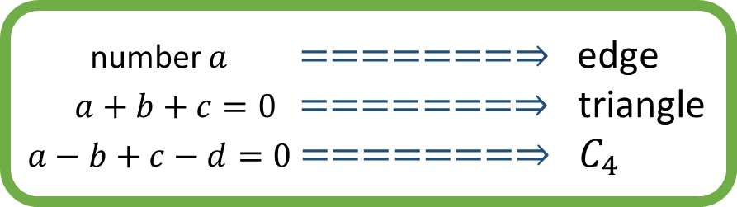
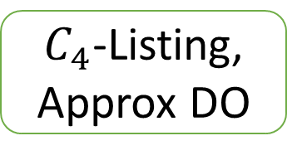

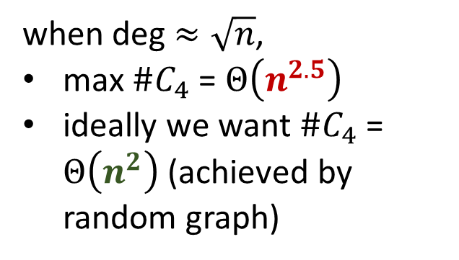
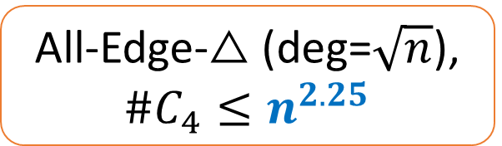
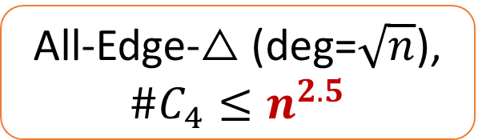
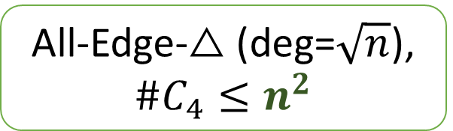
Cycle-removal framework [ABKZ’22]
Where do these $C_{4}$’s come from?
when deg$≈\sqrt{n}$,
max $\#C_{4}$ = $Θ\left(n^{2.5}\right)$
ideally we want $\#C_{4}$ = $Θ\left(n^{2}\right)$ (achieved by random graph)
3SUM
[Păt’10]
All-Edge-△ (deg=$\sqrt{n}$), $\#C_{4}≤n^{2.5}$
[Păt’10]
[ABKZ’22]
cycle-removal step 1
number $a$ $=======⇒$ edge
$a+b+c=0$ $=======⇒$ triangle
$a−b+c−d=0$ $=======⇒$ $C_{4}$
Our Theorem 1
“arithmetic cycle-removal”
All-Edge-△ (deg=$\sqrt{n}$), $\#C_{4}≤n^{2.25}$
(with some overhead)
[ABKZ’22] cycle-removal step 2
+ gadget reductions
$C_{4}$-Listing,
Approx DO
3SUM on Sidon sets
[Păt’10]
All-Edge-△ (deg=$\sqrt{n}$), $\#C_{4}≤n^{2}$
high additive energy ===> overhead in cycle-removal!

Slide 11
Plan
Theorem 1: Assuming 3SUM hypothesis, solving 3SUM on a Sidon set $A⊂[±poly(n)]$requires $n^{2−o\left(1\right)}$ time.
“3SUM instances with no additive structure are the hardest!”
Applications of Theorem 1 in fine-grained complexity:
  Tight LB for listing 4-cycles
  Improved LB for building approximate distance oracles
  Tight LB for solving 4-term linear equations in a given set (“4-LDT problem”)
Proof ideas for Theorem 1

Slide 12

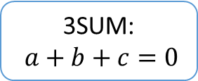
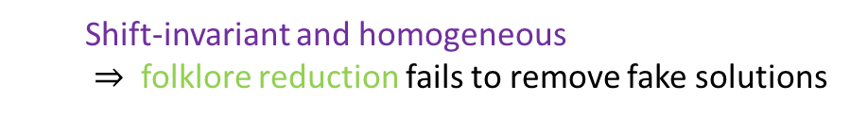
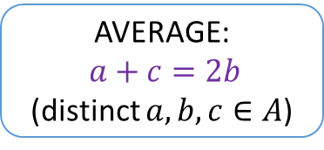
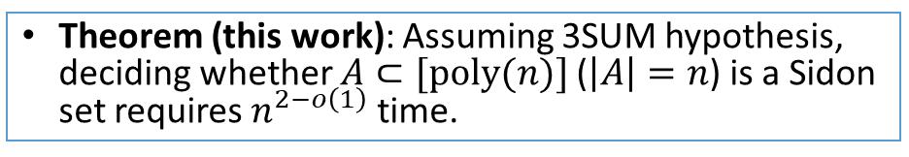
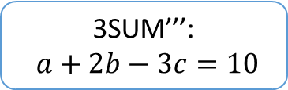
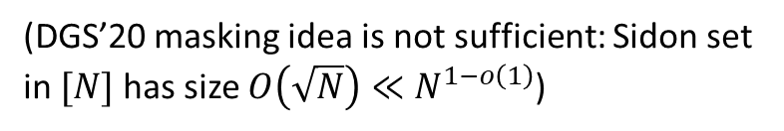
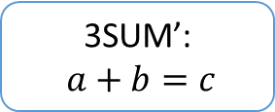
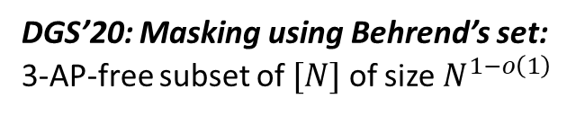
3- & 4-variate linear degeneracy testing (LDT)
3SUM’’’:
$a+2b−3c=10$
3SUM:
$a+b+c=0$
3SUM’:
$a+b=c$
(“3LDT” problems)
?? (Open question by Erickson 1999)
Yes! [Dudek-Gawrychowski-Starikovskaya STOC’20]
AVERAGE:
$a+c=2b$
(distinct $a,b,c∈A$)
(generalizable to other 3-LDTs)
  Shift-invariant and homogeneous
  $⇒$ folklore reduction fails to remove fake solutions
DGS’20: Masking using Behrend’s set: 3-AP-free subset of $[N]$ of size $N^{1−o\left(1\right)}$
implicit in DGS’20
3SUM
3SUM
on an average-free set
AVERAGE
(no fake solutions now)
Our Theorem 1
3SUM
on a Sidon set
SIDON: $a+b=c+d$
(a “4-LDT problem”)
(DGS’20 masking idea is not sufficient: Sidon set in $[N]$ has size $O\left(\sqrt{N}\right)≪N^{1−o\left(1\right)}$)
Theorem (this work): Assuming 3SUM hypothesis, deciding whether $A⊂[poly(n)]$($\left|A\right|=n$) is a Sidon set requires $n^{2−o\left(1\right)}$ time.
(generalizable to other 4-LDTs)

Slide 13
Plan
Theorem 1: Assuming 3SUM hypothesis, solving 3SUM on a Sidon set $A⊂[±poly(n)]$requires $n^{2−o\left(1\right)}$ time.
“3SUM instances with no additive structure are the hardest!”
Applications of Theorem 1 in fine-grained complexity:
  Tight LB for listing 4-cycles
  Improved LB for building approximate distance oracles
  Tight LB for solving 4-term linear equations in a given set (“4-LDT problem”)
Proof ideas for Theorem 1

Slide 14


Proof outline for Theorem 1
Theorem 1 (main technical result): Assuming the 3SUM hypothesis, solving 3SUM on a Sidon set requires $n^{2−o\left(1\right)}$ time.
Additive energy of set $A$: $E\left(A\right)=\left|\{\left(a,b,c,d\right)∈A×A×A×A :a+b=c+d\right\}|$
( $2{|A|}^{2}−|A|≤E\left(A\right)≤{|A|}^{3}$ )
  Random self-reduction [BDP’05] using a special hash family
Many small 3SUM instances with very few Sidon 4-tuples
3SUM with moderate additive energy $E\left(A\right)≤n^{2.9999}$
3SUM
(complemented by the DGS’20 masking idea)
  “Kernelization”: solve additively structured parts, and remove them
  Removal by brute-force enumeration
3SUM on Sidon sets

Slide 15
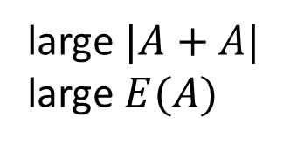
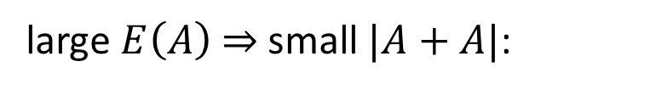
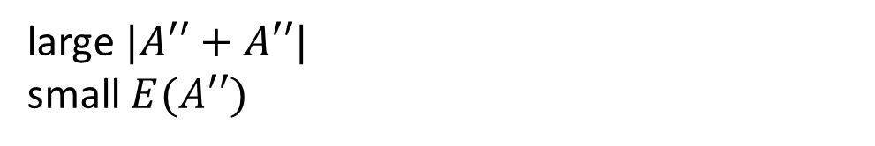
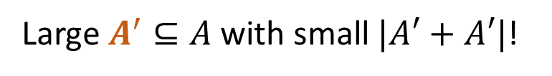
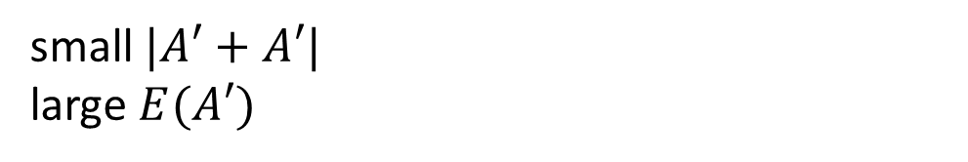

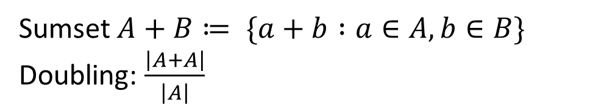
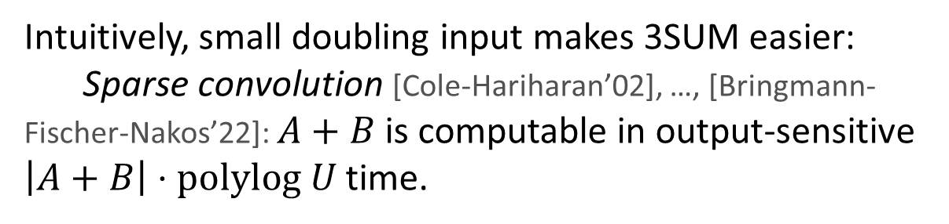
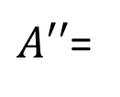

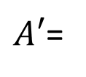
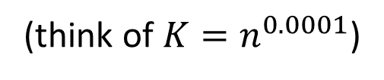
BSG theorem: doubling versus additive energy
Sumset $A+B≔ \{a+b :a∈A, b∈B\}$
Doubling: $\frac{\left|A+A\right|}{\left|A\right|}$
large $E\left(A\right)$ $⇒$ small $|A+A|$:
$$A=A^{′}∪A′′$$
Intuitively, small doubling input makes 3SUM easier:
Sparse convolution [Cole-Hariharan’02], …, [Bringmann-Fischer-Nakos’22]: $A+B$is computable in output-sensitive $\left|A+B\right|⋅polylog U$ time.
large $|A+A|$
large $E(A)$
$A′$=
small $|A′+A′|$
large $E(A′)$
Large $A^{′}⊆A$ with small $|A′+A′|$!
large $|A′′+A′′|$
small $E(A′′)$
$A′′$=
(think of $K=n^{0.0001}$)
Balog-Szemerédi-Gowers (BSG) theorem: If $E(A)≥{\left|A\right|}^{3}/K$, then exists $A′⊆A$ with $|A′|≥K^{−O\left(1\right)}|A|$, and $|A′+A′|≤K^{O\left(1\right)}|A′|$.
  An algorithmic version (adapting [Chan and Lewenstein 2015]) finds $A^{′}⊆A$ in $\tilde{O}(n⋅K^{O\left(1\right)})$ time.

Slide 16

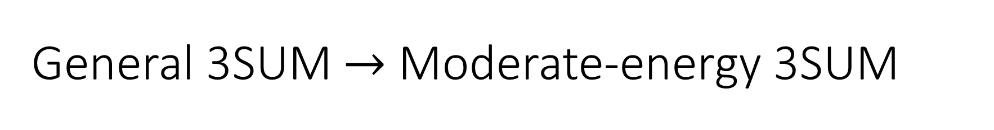
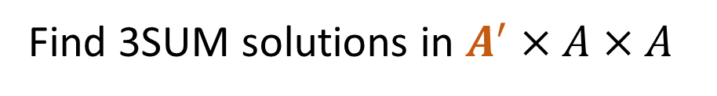

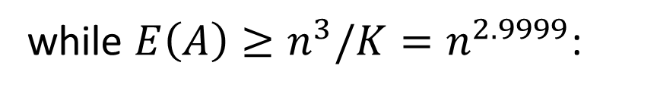


General 3SUM $→$ Moderate-energy 3SUM
Given 3SUM input $A$
while $E\left(A\right)≥{n^{3}/K=n}^{2.9999}$:
Find large $A′⊆A$ with small doubling
Find 3SUM solutions in $A^{′}×A×A$
$$A←A∖A^{′}$$
Terminates in $|A|/|A^{′}|{≤K}^{O\left(1\right)}$ iterations
Balog-Szemerédi-Gowers (BSG) theorem: If $E(A)≥{\left|A\right|}^{3}/K$, then exists $A′⊆A$ with $|A′|≥K^{−O\left(1\right)}|A|$, and $|A′+A′|≤K^{O\left(1\right)}|A′|$.
  An algorithmic version (adapting [Chan and Lewenstein 2015]) finds $A^{′}⊆A$ in $\tilde{O}(n⋅K^{O\left(1\right)})$ time.

Slide 17








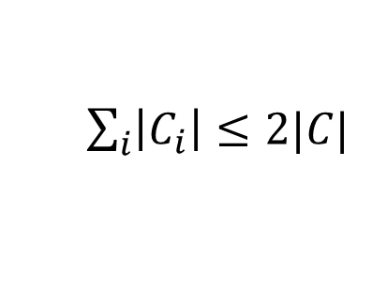




3SUM with small doubling
Lemma: Given size-$n$ sets $A,B,C⊂\left[U\right]$ where $\left|A+A\right|≤K\left|A\right|$, find
$\left(a,b,c\right)∈A×B×C$ such that $a+b=c$ in $\tilde{O}(Kn^{1.5})$ time
Special case for intuition: $A⊆\left[O(n)\right],\left|A\right|=n$, so $K≤O\left(1\right)$.
$$A$$
Small group $\left|B_{i}\right|≤\sqrt{n}$:
Brute force in $\tilde{O}(\left|B_{i}\right|⋅|C_{i}|)$ time. $\sum_{i}{\left|B_{i}\right|\left|C_{i}\right|}≤\sqrt{n}⋅2n$
$$A⊆\left[O(n)\right]$$
$$B$$
$$B_{1}$$
$$B_{2}$$
$$B_{i}$$
$$C$$
Large group $\left|B_{i}\right|>\sqrt{n}$:
FFT in $O(n\log{n})$ time.
#[large groups] $≤\sqrt{n}$
$$C_{i}$$
Find solutions in $(A+B_{i})∩C_{i}$
$\sum_{i}{\left|C_{i}\right|}≤2|C|$

Slide 18









3SUM with small doubling – General case $\left|A+A\right|≤K\left|A\right|$
Replace FFT by sparse convolution [Cole-Hariharan’02], …, [Bringmann-Fischer-Nakos’22]: $A+B$can be computed in $\left|A+B\right|⋅polylog U$ time.
Consider $m=O\left(\frac{U\log{n}}{\left|A\right|}\right)$ random shifted copies $A_{i}$ of $A$:
  $A_{i}≔A+s_{i}$, with random integer $s_{i}∈[−U,U]$
  $B_{i}≔A_{i}∩B$
  $C_{i}≔\left(A_{i}+A\right)∩C$ (again, find solutions in $(A+B_{i})∩C_{i}$)
With high probability, $B$ is covered by $\bigcup_{i}{B_{i}}$
$E\left[ \sum_{i}{\left|C_{i}\right|}\right]≤O\left(m⋅\frac{\left|A+A\right|}{U}⋅\left|C\right|\right)≤\tilde{O}(Kn)$
Omitted details: compute $B_{i},C_{i}$ efficiently
$$A$$
$$B$$
$$B_{1}$$
$$B_{2}$$
$$B_{i}$$
$$C$$
$$C_{i}$$

Slide 19

Open Questions
Additional result
(non-tight) lower bound for triangle-detection under strong-3SUM-hypothesis
Tight lower bounds for approximate distance oracles?
4SUM-hardness for deciding whether $A$ is Sidon set?
Thanks!

