Slide 1
A Massively Parallel Algorithm for Minimum Weight Vertex Cover
Mohsen Ghaffari
ETH Zurich
Ce Jin
Tsinghua U.
Daan Nilis
ETH Zurich
SPAA 2020

Slide 2
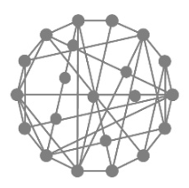

Massively Parallel Computation (MPC) Model
Input: Graph $G$ with $n$ vertices and $m$ edges
$M$ machines each with memory $S$. ( $S⋅M≈\tilde{Θ}\left(n+m\right)$ )
Computation proceeds in synchronous rounds
Optimize the round complexity
Supports many primitives in $O\left(1\right)$ rounds: sorting, prefix sum, array queries, etc.
[Goodrich-Sitchinava- Zhang’11, …]
Total data sent $≤S$
Total data received $≤S$
Input graph partitioned among $M$ machines
$$⋯$$
Round 1
Round 2

Slide 3
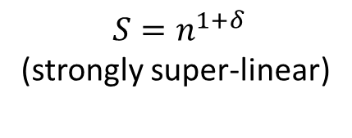

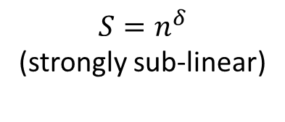

Massively Parallel Computation (MPC) Model
Input: Graph $G$ with $n$ vertices and $m$ edges
$M$ machines each with memory $S$. ( $S⋅M≈\tilde{Θ}\left(n+m\right)$ )
Three memory regimes (for constant $0<δ<1$):
easy
$$S=n^{1+δ}$$
(strongly super-linear)
$O(1)$-round Maximal Matching [Lattanzi-Moseley-Suri-Vassilvitskii, SPAA’11]
$O(({\log{\log{n})}}^{2})$-round $(1+ε)$-apx Maximum Matching
[Czumaj-Łącki-Mądry-Mitrović-Onak-Sankowski, STOC’18]
$O(\log{\log{n})}$-round $(1+ε)$-apx Maximum Matching
[Ghaffari-Gouleakis-Konrad-Mitrović-Rubinfeld, PODC’18]
[Assadi-Bateni-Bernstein-Mirrokni-Stein, SODA’19]
$O(\log{\log{n})}$-round Maximal Matching [Behnezhad-Hajiaghayi-Harris, FOCS'19]
$O(\log{\log{n})}$-round $(1+ε)$-apx Maximum Weight Matching
[Gamlath-Kale-Mitrović-Svensson, PODC'19]
$$S=\tilde{Θ}\left(n\right)$$
(near-linear)
hard
$$S=n^{δ}$$
(strongly sub-linear)
$\tilde{O}(\sqrt{\log{n}})$-round Maximal Matching [Ghaffari-Uitto, SODA'19]

Slide 4
Minimum Vertex Cover Problem
A vertex cover of an undirected graph $G=\left(V,E\right)$ is a subset $U⊆V$ such that every edge $e∈E$ has at least one endpoint in $U$.
NP-hard. Best known apx-ratio: 2 (optimal under Unique Games Conjecture)
In near-linear memory regime of MPC model:
(image from Wikipedia)
$O(\log{\log{n})}$-round $(2+ε)$-apx MinVC
[Ghaffari-Gouleakis-Konrad-Mitrović-Rubinfeld, PODC’18]
$O(\log{\log{n})}$-round Maximal Matching $⇒$ $2$-apx MinVC
[Behnezhad-Hajiaghayi-Harris, FOCS'19]
Minimum Weight Vertex Cover: Each vertex $v∈V$ has a weight $w\left(v\right)>0$. Find the vertex cover $U$ with minimum total weight $\sum_{v∈U}{w(v)}$.
Best known round complexity: $O(\log{n)}$ (by simulating PRAM algorithms in MPC)

Slide 5
Our result
($n=$ # vertices, $m=$ # edges)
In near-linear regime of MPC (each machine has memory $S=\tilde{Θ}\left(n\right)$), we can compute a $(2+ε)$-apx Minimum Weight Vertex Cover in $O(\log{\log{\frac{m}{n}})}$ rounds (with high probability).
($\frac{2m}{n}≤Δ≤n−1$)
Faster than previous $O(\log{\log{n})}$-round algorithms when e.g. $m=n⋅2^{{(log{\log{n)}}}^{2}}$.
(average degree)
(max degree)
We follow the framework of Ghaffari et al. [PODC’18] for (unweighted) VC, with some crucial changes to
handle the weighted case, and,
improve the round complexity.

Slide 6

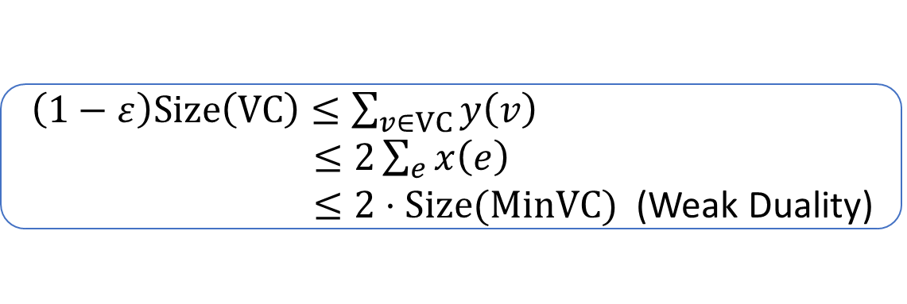
LOCAL Algorithm via Primal-Dual
First consider unweighted case ($w\left(v\right)=1$ for all $v$).
Every edge $e$ has a weight $x\left(e\right)>0$.
Define $y(v)≔\sum_{e∋v}{x\left(e\right)}$ (total incident weight of $v$).
Initialization: $x\left(e\right)←1/Δ$for all $e$. All edges are active.
while at least one edge is active:
for each active vertex $v$ with $y\left(v\right)≥\left(1−ε\right)$:
Freeze $v$ and its incident edges
for each active edge $e$:
$x\left(e\right)←x(e)/(1−ε)$
Return all frozen vertices as a vertex cover
Maintain $y\left(v\right)≤1$ for all $v$.
(i.e., $x(⋅)$ is a fractional matching)
Active edges $e$ have
$x\left(e\right)=\frac{1}{Δ}/{\left(1−ε\right)}^{\#rounds}$
$$⇓$$
Terminates in $O(\log{Δ})$ rounds
$\left(1−ε\right)Size\left(VC\right)≤\sum_{v∈VC}{y\left(v\right)}$
$≤2\sum_{e}{x\left(e\right)}$
$≤2⋅Size(MinVC)$ (Weak Duality)

Slide 7

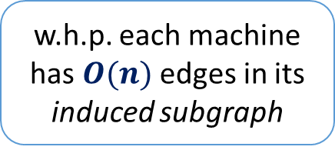


MPC algorithm [Ghaffari et al., PODC’18]
“Round Compression” idea [Czumaj et al. STOC’18]
In each phase:
$D≔1/[active x\left(e\right)]$ (active degree $≤D$)
Randomly partition the active vertices among $\sqrt{D}$ machines
Each machine “simulates” the LOCAL algo for $I=Θ(\log{D})$ rounds
until $D$ drops below $\log^{20}{n}$.
Finally solve the remaining sparse graph on one machine
w.h.p. each machine has $O(n)$ edges in its induced subgraph
After $I≔0.05\log_{1/(1−ε)}{D}$ rounds, active edges have $x\left(e\right)←x\left(e\right)⋅D^{0.05}$.
So $D←D^{0.95}$ after this phase.
$$\sum_{frozen u}{ }$$
$$\sum_{\begin{aligned}u,v on the \\ same machine\end{aligned}}{ }$$
$$\tilde{y}\left(v\right)≔ x\left(v,u\right)+\sqrt{D}⋅$$
$$x\left(v,u\right)$$
(initially $D=Δ$) #phases $=O\left(\log{\log{Δ}}\right)$
Instead of checking $\tilde{y}\left(v\right)≤1−ε$, pick random thresholds $T_{v}∈\left[1−2ε,1−ε\right]$ and check $\tilde{y}\left(v\right)≤T_{v}$.
Use $\tilde{y}\left(v\right)$ as an estimate of $y(v)$ during simulation.

Slide 8
Fewer Partitions
We can partition the active vertices among $\sqrt{d}$ machines (instead of $\sqrt{D}$), where
$d≔\frac{1}{n}\sum_{v active}{d\left(v\right)}$ ($d(v)$ is the active degree of $v$)
The memory bound still holds:
w.h.p. each machine $M_{i}$ has $\tilde{O}(n)$ edges in its induced subgraph.
Every edge has $1/{\left(\sqrt{d}\right)}^{2}$ probability of landing in $M_{i}$.
$E$[ #edges in $M_{i} ]=m/{\left(\sqrt{d}\right)}^{2}$ $=Θ\left(n\right)$.
When $d≫\log^{2}{n}$, we can show a high probability bound.
Fewer partitons $⇒$ Faster progress

Slide 9
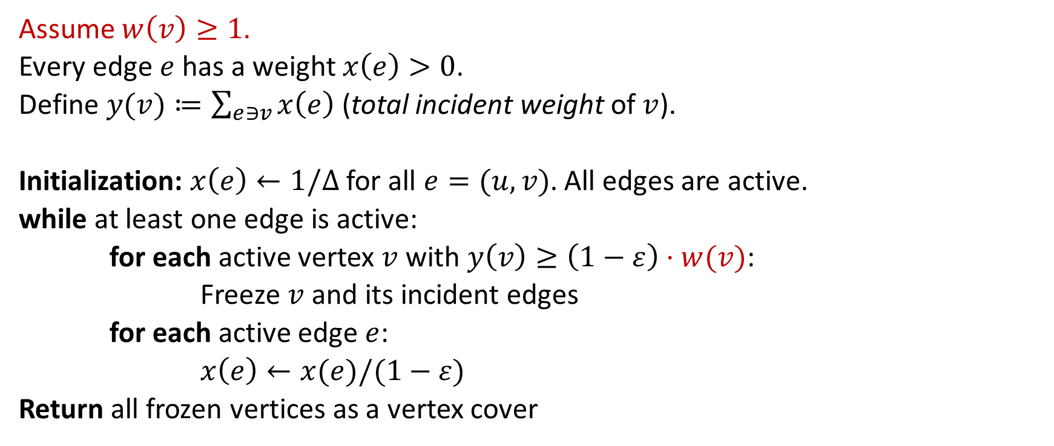
LOCAL Algorithm: Weighted Case
Maintain $y\left(v\right)≤w(v)$ for all $v$.
(i.e., $x(⋅)$ is a fractional matching)
Assume $w\left(v\right)≥1$.
Every edge $e$ has a weight $x\left(e\right)>0$.
Define $y(v)≔\sum_{e∋v}{x\left(e\right)}$ (total incident weight of $v$).
Initialization: $x\left(e\right)←1/Δ$ for all $e=(u,v)$. All edges are active.
while at least one edge is active:
for each active vertex $v$ with $y\left(v\right)≥\left(1−ε\right)⋅w(v)$:
Freeze $v$ and its incident edges
for each active edge $e$:
$x\left(e\right)←x(e)/(1−ε)$
Return all frozen vertices as a vertex cover
Active edges $e$ have
$x\left(e\right)=\frac{1}{Δ}/{\left(1−ε\right)}^{\#rounds}$
$$⇓$$
Terminates in $O(log\left(Δ⋅W\right))$ rounds

Slide 10
LOCAL Algorithm: Weighted Case
Maintain $y\left(v\right)≤w(v)$ for all $v$.
(i.e., $x(⋅)$ is a fractional matching)
Assume $w\left(v\right)≥1$.
Every edge $e$ has a weight $x\left(e\right)>0$.
Define $y(v)≔\sum_{e∋v}{x\left(e\right)}$ (total incident weight of $v$).
Initialization: $x\left(e\right)←\min\left\{ \frac{w(u)}{d(u)},\frac{w(v)}{d(v)} \right\}$ for all $e=(u,v)$. All edges are active.
while at least one edge is active:
for each active vertex $v$ with $y\left(v\right)≥\left(1−ε\right)⋅w(v)$:
Freeze $v$ and its incident edges
for each active edge $e$:
$x\left(e\right)←x(e)/(1−ε)$
Return all frozen vertices as a vertex cover
Initially it’s a valid fractional matching
Terminates in $O(log Δ)$ rounds

Slide 11
MPC Round Complexity
In each phase:
$d≔\frac{1}{n}\sum_{v active}{d\left(v\right)}$ ($d(v)$ is the active degree of $v$)
Randomly partition the active vertices among $\sqrt{d}$ machines
Each machine “simulates” the LOCAL algo for $I=Θ(\log{d})$ rounds
until $d$ drops below $\log^{20}{n}$.
$$x_{init}\left(e\right)←\min\left\{ \frac{w(u)}{d(u)},\frac{w(v)}{d(v)} \right\}$$
Claim: After this phase, $d$ drops to $O(d^{0.95})$.
(initially $d=2m/n$)
#phases $=O\left(\log{\log{(m/n)}}\right)$
Proof: Orient the edge $(u,v)$ from $u$ to $v$ iff $\frac{w(u)}{d(u)}<\frac{w(v)}{d(v)}$ at the beginning.
After $I$ rounds, $w\left(v\right)≥\left(\sum_{\left(u→v\right)}{\frac{w\left(u\right)}{d\left(u\right)}}+\sum_{\left(v→u\right)}{\frac{w\left(v\right)}{d\left(v\right)}}\right)/{\left(1−ε\right)}^{I}$ $≥outdeg\left(v\right)⋅\frac{w(v)}{d(v)}/{\left(1−ε\right)}^{I}$.
$outdeg\left(v\right)≤d\left(v\right)⋅{\left(1−ε\right)}^{I}=d(v)/d^{0.05}$.
So #edges = $\sum_{v}{outdeg\left(v\right)}≤nd{/d}^{0.05}$.

Slide 12

Ignoring Low-degree Vertices
Issue: Edges with low-degree endpoints have big weights.
This affects the concentration of $\tilde{y}(v)$.
$$x_{init}\left(e\right)←\min\left\{ \frac{w(u)}{d(u)},\frac{w(v)}{d(v)} \right\}$$
$$\sum_{frozen u}{ }$$
$$\sum_{\begin{aligned}u,v on the \\ same machine\end{aligned}}{ }$$
$$\tilde{y}\left(v\right)≔ x\left(v,u\right)+\sqrt{D}⋅$$
$$x\left(v,u\right)$$
Use $\tilde{y}\left(v\right)$ as an estimate of $y(v)$ during simulation.
Solution: Only consider vertices with degree $d\left(u\right)≥d^{0.95}$.
Other vertices are “inactive” in this phase (may become active in later phases).
We can still make progress:
#[“inactive” edges]$≤n⋅d^{0.95}$
#[other edges] $≤n⋅d^{0.95}$ (shown in the previous slide)
$⇒$ $d$ drops to $O\left(d^{0.95}\right)$ after this phase

Slide 13
Summary
Non-uniform initialization of edge weights
Analysis of progress via orienting edges
Ignoring low-degree vertices
Open Problem
$2$-approximate ($ε=0$) minimum weight vertex cover?
Thank you!

