Slide 1
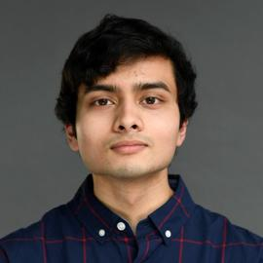
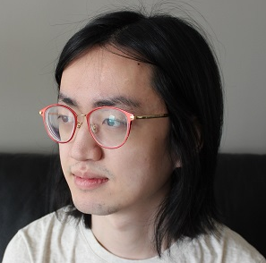
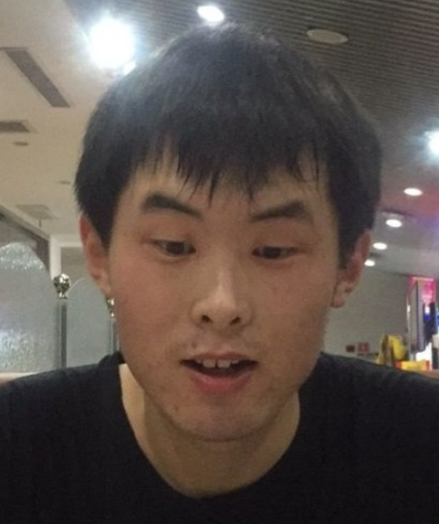
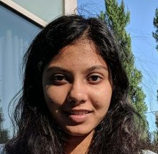
Improved Merlin-Arthur Protocols for Central Problems in Fine-Grained Complexity
Shyan Akmal
MIT
Lijie Chen
MIT
Ce Jin
MIT
Malvika Raj
UC Berkeley
Ryan Williams
MIT
ITCS 2022

Slide 2
Merlin-Arthur Proof Systems
Arthur wants Merlin to evaluate a function $f:\{0,1\}^{∗}→\{0,1\}^{∗}$ for him
On input $x∈\{0,1\}^{n}$, Merlin needs to convince Arthur that $f\left(x\right)=y$.
sends answer $y$ and proof $z$ of length $P(n)$
Prover
(Merlin)
Verifier
(Arthur)
runs (randomized) $V(x,y,z)$ in $T(n)$ time (on word-RAM)
Completeness: If $f\left(x\right)=y$, then exists $z$ such that $V(x,y,z)$ accepts with probability $1$.
Soundness: If $f\left(x\right)≠y$, then for all $z$, $V\left(x,y,z\right)$ rejects with probability $≥2/3$.
The Merlin-Arthur time of this protocol is $P\left(n\right)+T(n)$.
Non-deterministic algorithm: rejects with probability 1

Slide 3
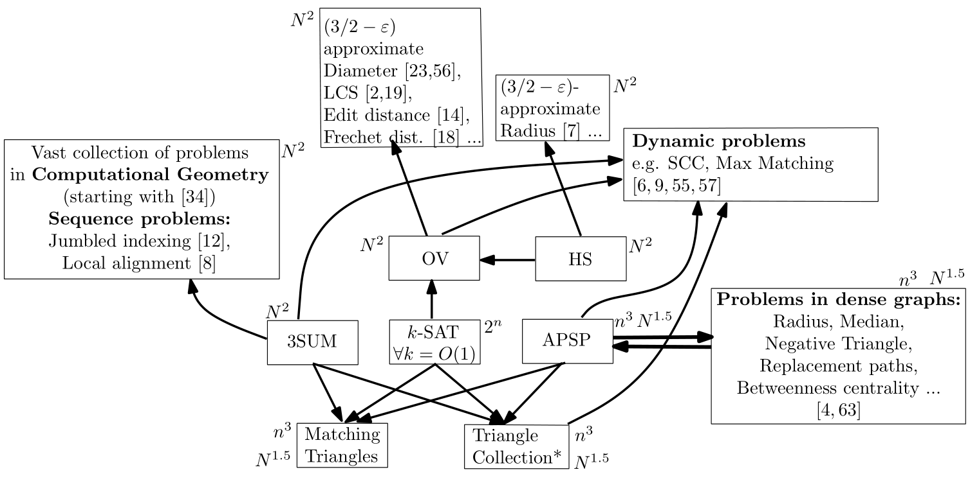
Fine-grained Complexity
Recent interest in Merlin-Arthur protocols for central problems in fine-grained complexity
(from Vassilevska Williams ’15)

Slide 4
Williams’ MA protocol for Orthogonal Vectors
OV Problem: Let $d=ω(log⁡n)$; given $A, B ⊆ {\left\{0, 1\right\}}^{d}$with $\left|A\right|=\left|B\right|=n$, determine if there is an OV pair $a∈A,b∈B$ so that $\left\langle a,b\right\rangle ≔ \sum_{1≤i≤d}{a_{i}⋅b_{i}}=0$.
Best known algorithms need $n^{2−o\left(1\right)}$ time [Abboud-Williams-Yu’15, Chan-Williams’16]
[Williams CCC’16]: Counting OV pairs can be done in $\tilde{O}(nd)$ MA time.
Near-optimal time
Nearly quadratic speedup (refuting MASETH)
Williams’ results led to many subsequent works:
[Björklund-Kaski’16]: MA Protocols for #k-Clique, Graph Coloring, Set Cover, ...
Further work in fine-grained cryptography and average-case fine-grained complexity [BRSV’18, …]
Question: Are there fast MA protocols for other problems in fine-grained complexity?
This work: Near-optimal MA protocols for 3SUM and APSP (and many more…)

Slide 5
New Results
3-SUM, (min,+)-convolution, Subset Sum
Counting Zero-weight Cliques, APSP
$k$-Unsatisfiability
Quantified Boolean Formula

Slide 6
Result 1: $k$-SUM
$k$-SUM Problem (for fixed integer $k≥3$): Given $n$ integers, decide if there exist $k$ of them that sum to zero.
Best known algorithm for 3-SUM runs in $n^{2−o(1)}$ time
for $k$-SUM: $n^{\left\lceil k/2\right\rceil −o(1)}$time
Theorem: Certifying that no $k$-SUM solution exists can be done in MA time $\tilde{O}\left(n^{k/3}\right)$.
“NO 3-SUM” can be certified in $\tilde{O}(n)$ MA time (near-optimal).
Previously known [Carmosino-Gao-Impagliazzo-Mihajlin-Paturi-Schneider’16]:
“NO 3-SUM” can be certified in $\tilde{O}(n^{1.5})$ Nondeterministic time.
$\tilde{O}$ hides $polylog(n)$ factors

Slide 7
Implications of the 3-SUM protocol
Subset Sum Problem: Given $n$ integers and a target $t$, decide if there exists a subset of them that sums to $t$.
Best known algorithm runs in $O(2^{n/2})$ time [Horowitz-Sahni’74]
Theorem: “NO Subset Sum” can be certified in ${O^{∗}(2}^{n/3})$MA time.
Previous result [Nederlof’17]: “NO Subset Sum” in $O^{∗}(2^{0.49991n})$ MA Time.
$(min,+)$-convolution: Given integers $a_{1},…,a_{n}$ and $b_{1},…,b_{n}$, compute $c_{i}=\min_{1≤j<i}{\{a_{j}+b_{i−j}}\}$ for all $i$.
Using the techniques from [Vassilevska-Williams’09], we obtain:
Theorem: $(min,+)$-convolution can be computed in $\tilde{O}(n)$ MA time.
$O^{∗}$ hides $poly(n)$ factors

Slide 8
Result 2: Counting Cliques
Previous results for Counting $k$-cliques in a $n$-vertex graph (for fixed integer $k≥3$):
[Williams’16]: $\tilde{O}\left(n^{\left\lfloor k/2\right\rfloor +2}\right)$ MA time
[Björklund-Kaski’16]: $\tilde{O}\left(n^{ωk/6}\right)$ MA time (for $k$ divisible by 6).
[Goldreich-Rothblum’17]: $\tilde{O}\left(n^{k/2}\right)$ MA time
(nearly quadratic speedup)
#ZeroWeight-$k$-clique: Given a simple undirected graph (with $n$ vertices and $m$ edges) with integer edge weights, count the number of $k$-cliques with zero total weight.
Theorem: #ZW-$k$-Clique can be solved in MA time $\tilde{O}(n^{⌈k/2⌉})$.
#ZW-4-Clique in MA time $\tilde{O}(n^{2})$
Further improvement for odd $k$ on sparse graphs
e.g., #ZW-Triangle in $\tilde{O}(m)$ MA time with $\tilde{O}(n)$ proof length
Implications: APSP (and $(min,+)$-product) can be solved in $\tilde{O}(n^{2})$MA time
Previously known [CGIMPS’16]: APSP in $\tilde{O}\left(n^{2.94}\right)$ Non-deterministic time

Slide 9
Result 3: $k$-UNSAT
Input: an $n$-variable $m$-clause $k$-CNF
Example: $\left(x_{1}∨¬x_{2}∨x_{3}\right)∧\left(x_{2}∨x_{4}∨¬x_{5}\right)$ is a (satisfiable) 3-CNF
Best known algorithms for $k$-CNF-SAT runs in $O^{∗}(2^{n−cn/k})$ time (for some constant $c$)
Theorem: Certifying that the $k$-CNF is unsatisfiable can be done in ${{O^{∗}(2}^{n/2−c^{′}n/k})}^{ }$ MA time (for some constant $c′$)
Previously known: #SAT in ${O^{∗}(2}^{n/2})$ MA time [Williams’16]
Remark:
Williams’ protocol algebrizes (in the sense of [Aaronson-Wigderson’09]).
There is NO algebrizing protocol for $k$-UNSAT in ${2^{n/2}/n^{ω(1)}}^{ }$ time.
Therefore we have to exploit non-algebrizing properties in our $k$-UNSAT protocol.
$O^{∗}$ hides $poly(n,m)$ factors

Slide 10
Result 4: Quantified Boolean Formula
Given a Quantified Boolean Formula in prenex normal form,
$$\left(Q_{1}x_{1}\right)⋯(Q_{n}x_{n}) F(x_{1}, . . . , x_{n})$$
where $Q_{i}∈\{∃, ∀\}$ and $F$ is a formula of size $m$, decide whether it is a True QBF.
PSPACE-complete problem with an $O^{∗}(2^{n})$ time algorithm
[Williams’16] gave a 3-round (AMA) protocol in $O^{∗}(2^{2n/3})$time
Open question [Williams’16]: Is there an MA protocol in ${O^{∗}(2}^{\left(1−ε\right)n})$ time?
Theorem: True QBF can be certified in ${O^{∗}(2}^{4n/5})$MA time.
$O^{∗}$ hides $poly(n,m)$ factors

Slide 11
3-SUM, (min,+)-convolution, Subset Sum
This talk
Counting Zero-weight Cliques, APSP
$k$-Unsatisfiability
Quantified Boolean Formula

Slide 12
NO-3-SUM
Input integers $a_{1},…,a_{n}$.
A 3-SUM solution: $\left(i,j,k\right)∈{\left[n\right]}^{3}$ such that $a_{i}+a_{j}+a_{k}=0$ (repeated indices allowed)
Task: Certify that no 3-SUM solution exists, in $\tilde{O}(n)$ MA time.

Slide 13
Step 1: NO-3-SUM $→$ #3-SUM with small input range
Input integers $a_{1},…,a_{n}$.
A 3-SUM solution: $\left(i,j,k\right)∈{\left[n\right]}^{3}$ such that $a_{i}+a_{j}+a_{k}=0$ (repeated indices allowed)
Task: Certify that no 3-SUM solution exists, in $\tilde{O}(n)$ MA time.
Idea from [CGIMPS’16]: Pick a positive integer integer $d$,
A relaxed 3-SUM solution: $\left(i,j,k\right)∈{\left[n\right]}^{3}$such that $a_{i}+a_{j}+a_{k}≡0 (mod d)$
Exists $d≤n^{2}$ such that there are at most $\tilde{O}\left(n\right)$ relaxed solutions.
Sends $d≤n^{2}$ and the list $\{\left(i_{1},j_{1},k_{1}\right),…,(i_{m},j_{m},k_{m})\}$ of all $m≤\tilde{O}(n)$ relaxed solutions
Prover
Verifier
Checks:
The 3-tuples in the list are distinct relaxed solutions
None of the relaxed solutions are real solutions
The input has exactly $m$ relaxed solutions
New task: Given input integers $a_{1},…,a_{n}∈\{1,2,…,d\}$ (where $d≤n^{2}$), prove that the number of tuples $\left(i,j,k\right)∈{\left[n\right]}^{3}$ such that $a_{i}+a_{j}+a_{k}=t$ is $m_{t}$.
where $t∈\{d,2d,3d\}$, and $m=m_{d}+m_{2d}+m_{3d}$

Slide 14
Step 2: Verifying Polynomial Coefficients
= $b_{t}$
Given integers $a_{1},…,a_{n}∈\{1,2,…,n^{2}\}$, prove that
the number of tuples $\left(i,j,k\right)∈{\left[n\right]}^{3}$ such that $a_{i}+a_{j}+a_{k}=t$ is $m_{t}$.
Define degree-$n^{2}$ polynomial $A\left(x\right)≔\sum_{i∈[n]}{x^{a_{i}}}$, and let $A{\left(x\right)}^{3}=\sum_{1≤j≤3n^{2}}{b_{j}x^{j}}$
Inspired by [Nederlof’17], let $T=\{ 1≤j≤3n^{2} | j≡t \left(mod n\right) \}$
Merlin sends $\{m_{j}\}_{j∈T}$and claims $m_{j}=b_{j}$ for all $j∈T$.
Arthur picks random $r∈F_{p}$, and checks $\sum_{j∈T}{m_{j}r^{j}}=\sum_{j∈T}{b_{j}r^{j}}$
Failure probability $≤3n^{2}/p$, by Schwartz-Zippel Lemma
$t∈T$and $\left|T\right|≤3n^{2}/n=O(n)$

Slide 15
Step 2: Verifying Polynomial Coefficients (cont’d)
= $b_{t}$
Given integers $a_{1},…,a_{n}∈\{1,2,…,n^{2}\}$, prove that
the number of tuples $\left(i,j,k\right)∈{\left[n\right]}^{3}$ such that $a_{i}+a_{j}+a_{k}=t$ is $m_{t}$.
Define degree-$n^{2}$ polynomial $A\left(x\right)≔\sum_{i∈[n]}{x^{a_{i}}}$, and let $A{\left(x\right)}^{3}=\sum_{1≤j≤3n^{2}}{b_{j}x^{j}}$
Inspired by [Nederlof’17], let $T=\{ 1≤j≤3n^{2} | j≡t \left(mod n\right) \}$
How to evaluate $\sum_{j∈T}{b_{j}r^{j}}$?
$t∈T$and $\left|T\right|≤3n^{2}/n=O(n)$
Note that $A{\left(rx\right)}^{3}=\sum_{1≤j≤3n^{2}}{b_{j}r^{j}x^{j}}$
$A{\left(rx\right)}^{3}mod (x^{n}−1)=\sum_{1≤j≤3n^{2}}{b_{j}r^{j}x^{j mod n}}$
$\sum_{j∈T}{b_{j}r^{j}}$ equals the $x^{t mod n}$ term coefficient of $A{\left(rx\right)}^{3} mod (x^{n}−1)$
$$=(A\left(rx\right) mod \left(x^{n}−1\right) )^{3} mod \left(x^{n}−1\right)$$
Total MA time = $\tilde{O}\left(|T|+n\right)≤\tilde{O}(n)$
=$(\sum_{i∈[n]}{r^{a_{i}}⋅x^{a_{i} mod n}})^{3} mod \left(x^{n}−1\right)$
Computable in $\tilde{O}(n)$ time using FFT

Slide 16
Open problems
Can we certify “NO Subset Sum” in ${O^{∗}(2}^{n/4})$ MA time?
We achieved ${O^{∗}(2}^{n/3})$
Can we certify True QBF in ${O^{∗}(2}^{n/2})$ MA time?
We achieved ${O^{∗}(2}^{4n/5})$
Thanks!

